Slide 1
Network Games Programming
Mario.Soflano@gcu.ac.uk
Room M611A
Discord: MarioSoflano#3996

Slide 2
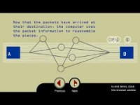
Notes:
https://www.dnsstuff.com/packet-sniffers
To truly understand the power of packet sniffers and the network security as a whole, it’s important to establish a sound knowledge base of internet routing. Let’s start at the beginning. Every email you send, webpage you open, and file you share is distributed across the internet as thousands of small, manageable chunks known as data packets. These packets are transmitted through a protocol stack known as the Transmission Control Protocol/Internet Protocol (TCP/IP). The TCP/IP is broken into four layers: the application protocol layer, transmission control protocol (TCP) layer, internet protocol (IP) layer, and hardware layer.
Each packet moves through your network’s application layer to the TCP layer, where it’s assigned a port number. Next, the packet migrates to the IP layer and receives its destination IP address. Once a packet has a port number and IP address, it can be sent over the internet. Sending is carried out through the hardware layer, which converts packet data into network signals. When a packet arrives at its destination, the data used to route the packet (port number, IP address, etc.) is removed, and the packet moves on through the new network’s protocol stack. Once it reaches the top, it’s reassembled into its original form.

Slide 3
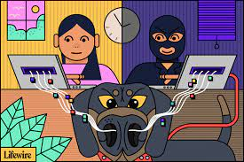
Packet Sniffling - what
Packet sniffing is a term generally used for the reading of packet data for a purpose other than normal network operation. This can be done for many different purposes including attempting to steal login information or cheating in networked games.
Notes:
https://www.lifewire.com/what-is-a-packet-sniffer-2487312

Slide 4
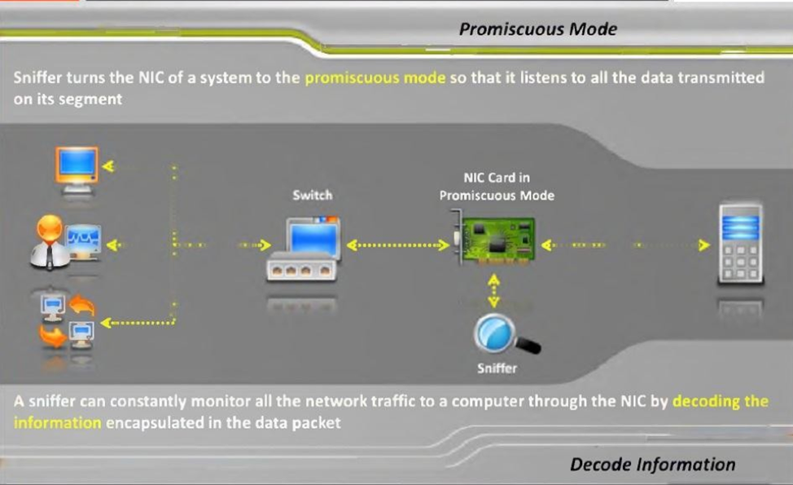
Packet Sniffling – how does it work
Notes:
https://www.dnsstuff.com/packet-sniffers
https://docs.rackspace.com/blog/packet-sniffers-and-how-you-protect-yourself/
Packet sniffers work by intercepting traffic data as it passes over the wired or wireless network and copying it to a file. This is known as packet capture. While computers are generally designed to ignore the hubbub of traffic activity from other computers, packet sniffers reverse this. When you install packet sniffing software, the network interface card (NIC)—the interface between your computer and the network—must be set to promiscuous mode. This commands the computer to capture and process, via the packet sniffer, everything that enters the network.
What can be captured depends on the network type. For wired networks, the configuration of network switches, which are responsible for centralizing communications from multiple connected devices, determines whether the network sniffer can see traffic on the entire network or only a portion of it. For wireless networks, packet capture tools can usually only capture one channel at a time unless the host computer has multiple wireless interfaces.

Slide 5
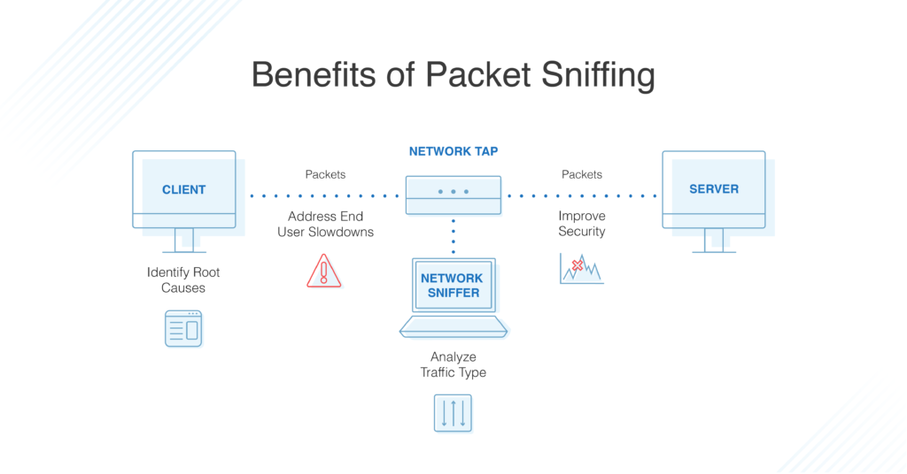
The benefits of Packet Sniffers
Notes:
A packet sniffer can help you target new resources when expanding your network capacity, manage your bandwidth, increase efficiencies, ensure delivery of business services, enhance security, and improve end-user experience.
These tools aid in the identification, classification, and troubleshooting of network traffic by application type, source, and destination. There are a variety of tools on the market, most of which rely on application program interfaces (APIs) known as pcap (for Unix-like systems) or libcap (for Windows systems) to capture network traffic.

Slide 6
The benefits of Packet Sniffers
Identify the Root Cause: Because packet sniffers view and gather information for all the traffic across the network, they can evaluate critical network pathways to help admins determine whether the application or the network is the cause of poor user experience. With this information in hand, admins are better equipped to pinpoint—and resolve—the origin of an issue.
When users report slowness, admins can use PCAP analysis to measure the network response time—also known as network path latency—and determine the amount of time required for a packet to travel across a network path from sender to receiver. This enables admins to quickly determine the cause of slowdowns and identify affected applications, so they can take action.
Analyze Traffic by Type. When evaluating network and application performance issues, having a firm grasp of the traffic on your network is paramount. With the right IP sniffer and packet analyzer, traffic is categorized into types based on destination server IP addresses, ports used, and measurement of the total and relative volumes of traffic for each type. This empowers you to identify excessive levels of non-business traffic (such as social media and external web surfing) that may need to be filtered or otherwise eliminated. You can also identify traffic flowing over a network link as well as traffic to specific servers or applications for capacity management purposes

Slide 7
The benefits of Packet Sniffers
Improve Bandwidth. When users complain “the network is slow,” or “the internet is down”, you need to understand how your network bandwidth is being used and by whom. A Wi-Fi packet sniffer can retrieve performance metrics for autonomous access points, wireless controllers, and clients. Many also offer fault, performance, and network availability monitoring, cross-stack network data correlation, hop-by-hop network path analysis, and much more, to help you detect potential issues and minimize network downtime.
Improve Security. A high volume of outbound traffic could indicate a hacker is using your applications, either to communicate externally or to transfer a large amount of data. A packet sniffer can highlight unusual spikes in traffic so you can dig deeper to determine whether a cybercriminal is at work.

Slide 8
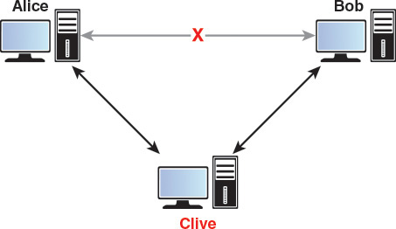
Packet Sniffers – Types of Attack
Man-in-the-Middle Attack
Notes:
In a man-in-the-middle attack, a computer somewhere on the route from source to destination is sniffing packets, without the knowledge of the source and destination computers. Practically speaking, there are a few different ways this can occur. Any computer using an unsecured or public Wi-Fi network could have all of its packet information read by another machine on that network. (This is why it is generally a good idea to use an encrypted VPN when on a Wi-Fi network at the local coffee shop). If on a wired network, it could be that a gateway machine is sniffing packets—either because of some sort of malware, or due to a nosy system administrator. And if, for some reason, government agents are targeting your game, it is also possible that software installed at an ISP is attempting to gain access to the data. The figure shows: A man-in-the-middle attack, with a message between Alice and Bob being read by Clive
Technically, a player could intentionally set up a man-in-the-middle for the purposes of sniffing the game. This may be a concern on a closed platform such as a console, but at least on PC or Mac, you should assume that the player always has access to all of the data transmitted over the network, anyway. So for the rest of this discussion of man-in-the-middle, we will assume that the “man” is a third party unknown to both the source and destination computer.

Slide 9
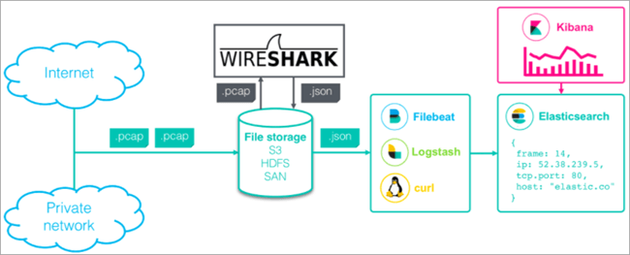
Packet Sniffers – Types of Attack
Packet Sniffing on a Host Machine
Notes:
https://www.softwaretestinghelp.com/network-packet-sniffers/
While only games that transmit sensitive data need to worry about a man-in-the-middle attack, every networked game is susceptible to a host machine intentionally sniffing packets.
It’s worthwhile to consider what exactly a player packet sniffing on the host machine seeks to accomplish. The player on the host machine is generally trying to utilize an information cheat, meaning he or she is trying to glean information that he or she should not know. A common refrain to prevent cheating in this case is to limit the amount of information transmitted to each host. In a client-server game, it is very much possible for the server to limit the data it sends to each client. For example, suppose a networked game supports players moving undetected in stealth mode. If the server still sends replication updates on a character in stealth, then a player could absolutely glean the position of these stealth players from the packets. On the other hand, if replication updates for position pause while a character is in stealth, there will be no way for the client to know the current position of the character.

Slide 10
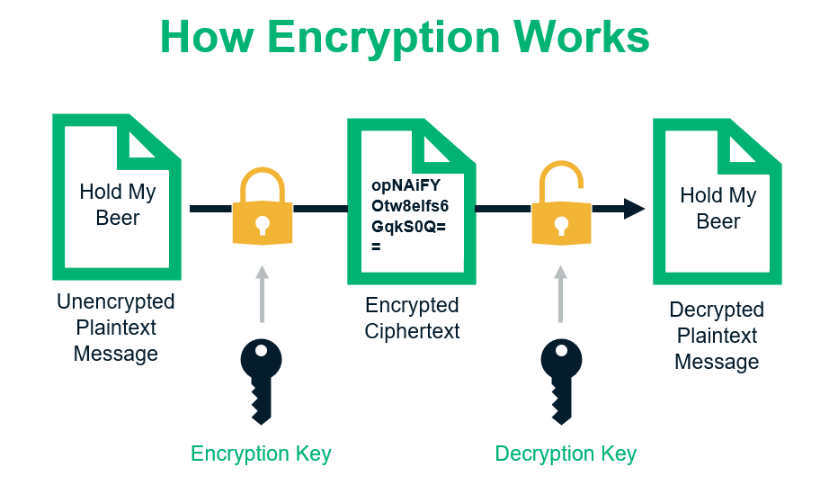
Notes:
https://sectigostore.com/blog/what-is-asymmetric-encryption-how-does-it-work/

Slide 11
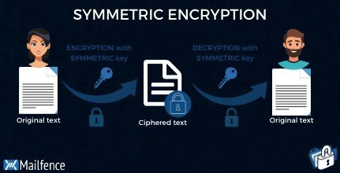
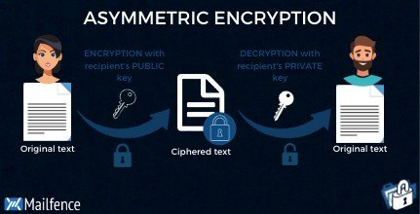
Types of Encryption
Symmetric encryption is a type of encryption where only one key (a secret key) is used to both encrypt and decrypt electronic information. The entities communicating via symmetric encryption must exchange the key so that it can be used in the decryption process.
Asymmetric encryption where a pair of keys, one public and one private, is used to encrypt and decrypt messages.
Notes:
https://blog.mailfence.com/symmetric-vs-asymmetric-encryption/

Slide 12
Symmetric Encryption
There are two types of symmetric encryption algorithms:
Block algorithms. Set lengths of bits are encrypted in blocks of electronic data with the use of a specific secret key. As the data is being encrypted, the system holds the data in its memory as it waits for complete blocks.
Stream algorithms. Data is encrypted as it streams instead of being retained in the system’s memory.
Some examples of symmetric encryption algorithms include:
AES (Advanced Encryption Standard)
DES (Data Encryption Standard)
IDEA (International Data Encryption Algorithm)
Blowfish (Drop-in replacement for DES or IDEA)
RC4 (Rivest Cipher 4), RC5 (Rivest Cipher 5), RC6 (Rivest Cipher 6)
AES, DES, IDEA, Blowfish, RC5 and RC6 are block ciphers. RC4 is stream cipher.
Notes:
https://www.ibm.com/docs/en/ztpf/2020?topic=concepts-symmetric-cryptography
Some examples of where symmetric cryptography is used are:
Payment applications, such as card transactions where PII needs to be protected to prevent identity theft or fraudulent charges
Validations to confirm that the sender of a message is who he claims to be
Random number generation or hashing

Slide 13
Asymmetric Encryption
The public key and the private key are not the same thing but they are related. Moreover, you create your message then encrypt it with the recipient’s public key. After that, if the recipient wants to decrypt your message he/she would have to do it with his/her private key. Keep the (private) key private at all times, the best practice would be to store it locally.
Main Characteristics of Asymmetric Encryption
1. Asymmetric Encryption Is Designed for Securing Data & Key Exchanges in Public Channels
2. Asymmetric Encryption Keys Are Large
Notes:
Before moving on, let’s better understand asymmetric encryption with a hypothetical example.
Imagine you want to protect a precious jewelry box that you’re sending in the mail to your significant other. To keep it secure in transit, you use a special lock that needs two number combinations. One number can lock the box (the number which you have) and the other number combination can unlock it (which your recipient has).
First, you put the items you wish to protect inside the box. Then you lock the box with a specific number combination before placing it in the mail. Once it arrives, your significant other uses her number combination to unlock the box and access its contents. Because she never shares that number with anyone and keeps it to herself, it means that no one else can use it.
Now, let’s apply this concept to understanding how asymmetric encryption works within the realm of public key infrastructure.
All the data you send via the internet is in plaintext. This means that anyone who gets access to it can read and interpret it. Now, of course, you can encrypt the data using a private key. Once the data has been converted into ciphertext, you can’t decrypt it using the same key. The ciphertext can be decrypted only with the corresponding private key. In general, the sender must have access to the public key, and the recipient must have its corresponding private key.
https://sectigostore.com/blog/what-is-asymmetric-encryption-how-does-it-work/

Slide 14
Asymmetric vs Symmetric
Advantages of Symmetric key ciphers:
It is relatively inexpensive to produce a strong key for these ciphers.
The keys tend to be much smaller for the level of protection they afford.
The algorithms are relatively inexpensive to process.
Disadvantages of Symmetric:
Less secure
Advantages of Asymmetric key ciphers:
Much more secure than Symmetric
Makes Key Distribution Easy
Makes Digital Signatures Possible
Disadvantages of Asymmetric:
Asymmetric Encryption Is a Resource-Hogging Proces
Slower
Notes:
https://sectigostore.com/blog/what-is-asymmetric-encryption-how-does-it-work/
The advantages of symmetric encryption are that it is easy to set up and can be done in a jiffy. Moreover, it is pretty straightforward, all ages and backgrounds can use it. Asymmetric encryption is more difficult to comprehend and use.
The drawback is that the secret key needs to be shared with the recipient. In the case of Password Encrypted Messages, the secret key is encrypted with the user password. Just make sure that the password is not easily guessed. If you use the same secret key to encrypt all your emails if someone learns that secret key. You will compromise all your encrypted emails.

Slide 15
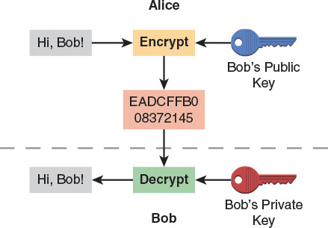
Packet Sniffers – Types of Attack
Man-in-the-Middle Attack - Solution
Notes:
The general approach to combatting the man-in-the-middle is to encrypt all transmitted data. In the case of a networked game, prior to implementing any sort of encryption system, one should consider whether the game in question contains any sensitive data that needs to be encrypted. If your game contains any microtransactions where a player can purchase in-game items, it absolutely needs to encrypt any data related to purchases. If you are storing or even just processing credit card information, the Payment Card Industry Data Security Standard (PCI DSS) may be a legal requirement. However, even if there are no in-game purchases, any game where a player logs in to an account that saves progress, such as a MOBA or MMO, should encrypt data related to the login process. In both of these cases, there is a monetary incentive for a third party to steal information—whether credit card or login. So it is imperative that your game protects player’s valuable data from a man-in-the-middle.
On the other hand, if the only data your game transmits over the network is replication data (or the like), it doesn’t really matter if the man-in-the-middle intercepts this data. Thus, you could leave the data unencrypted and it wouldn’t be a big issue. That being said, there may still be some value in encrypting the data to prevent host packet sniffing, which is discussed shortly.
If you come to the conclusion that your game does send sensitive data that needs to be protected from outside parties, then using a proven encryption system is the recommended course of action. Specifically, you will want to use public key cryptography, a type of cryptography well suited for transmitting secure information. Suppose that Alice and Bob want to transmit encrypted messages to each other. First, before they begin talking to each other, Alice and Bob both generate different private and public keys. The private keys remain private to whoever generated the key—they should never be shared with anyone else. When Alice and Bob first handshake with each other, they will exchange their public keys. Then when Alice sends a message to Bob, she will encrypt the message using Bob’s public key. This message can then only be decrypted using Bob’s private key. In essence, this means that Alice can send messages to Bob that only he can read, and Bob can send messages to Alice that only she can read. This is the essence of public key cryptography, and is illustrated in the figure.
In the case of a networked game where there’s a login server, the client would have access to the server’s public key. When the client wishes to log in to the server, their login and password are encrypted using the server’s public key. This login packet can then only be decrypted by the server’s private key, which hopefully only the server knows!

Slide 16

Notes:
https://www.khanacademy.org/computing/computer-science/cryptography/modern-crypt/v/intro-to-rsa-encryption
Arguably the most popular public key cryptography system in use today is the RSA system designed in 1977 by Rivest, Shamir, and Adelman. In RSA, the public key is based on a very large number that is a semiprime, meaning it is the product of two prime numbers. The private key is then based on the prime number factorization of the semiprime. The system works because no known polynomial-time algorithm exists for integer factorization, and brute-forcing the factorization of a 1024- or 2048-bit number that is the product of two large prime numbers, at this time, is likely impossible even on the most powerful supercomputer in the world.
Since RSA is such a well-established cryptography system, it would be a waste of resources to attempt to implement it on your own. Instead, use a trusted open-source implementation of RSA such as the implementation provided in OpenSSL. Because OpenSSL is released under a free software license, even commercial projects should have no issue with using it.
In this case, encrypting the data is a deterrent but is not a foolproof measure. The reason for this is a game executable on any platform can always be hacked, so encrypting the game data won’t prevent someone from learning how to decrypt the data. Somewhere, there must be code within the executable that knows how to decrypt the data the executable is to receive. Once the decryption scheme is determined, the packet data can be read as if it weren’t encrypted.
That being said, reverse engineering the decryption code and finding the private key stored in the client does take some time. So one way to make it more difficult for potential cheaters is to still encrypt the data, but change the encryption keys and memory offsets to those keys on a regular basis. This will then require someone to repeat the reverse engineering process every time your game is updated. Similarly, if your game changes the format and ordering of packets on a regular basis, this renders cheats that rely on a specific-packet format obsolete. Once again, this makes players spend time to learn the new format and get the cheats to work again. So, changing the encryption or packet format regularly will make developing cheats for your game more annoying. Hopefully, this means most players give up in developing cheats. But either way, you still have to accept the fact that you will never be able to prevent dedicated individuals from sniffing all of the packets on a host machine.
It’s worthwhile to consider what exactly a player packet sniffing on the host machine seeks to accomplish. The player on the host machine is generally trying to utilize an information cheat, meaning he or she is trying to glean information that he or she should not know. A common refrain to prevent cheating in this case is to limit the amount of information transmitted to each host. In a client-server game, it is very much possible for the server to limit the data it sends to each client. For example, suppose a networked game supports players moving undetected in stealth mode. If the server still sends replication updates on a character in stealth, then a player could absolutely glean the position of these stealth players from the packets. On the other hand, if replication updates for position pause while a character is in stealth, there will be no way for the client to know the current position of the character.
In general, you should assume any data sent to each host can be examined by a player trying to cheat. Thus if the game ensures that only the critical information relevant to each host is transmitted, then it will minimize the potential for cheating. This will be much easier to enforce in a client-server topology than on a peer-to-peer topology, since peer-to-peer can only work if all data relevant to the game is sent to every peer. Thus a peer-to-peer game needs to use other approaches to combat cheating.

Slide 17
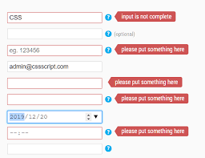
Invalid Input – Solution: Input Validation
Input validation strives to ensure that no player performs an action that is invalid. This method of cheat prevention can work equally as well for both client-server games and peer-to-peer games. The implementation of input validation boils down to the simple premise that the game should never blindly execute an action from a packet sent over the network. Instead, the action should first be validated to ensure that it is valid at the point in time in question.
For example, suppose that a packet is sent over the network requesting that Player A fire their gun. The receiving machine should never assume that it is valid for Player A to fire. It should first be confirmed that Player A has a weapon, the weapon has bullets, and the weapon is not on a cool down. If any of these conditions are not met, the fire request should be rejected.
Notes:
If invalid actions are detected, it may be tempting to boot the offending player. However, you should consider the possibility that the invalid input was accidental, perhaps due to latency or packet loss. For example, suppose that players can cast spells in a particular game. In said game, let’s suppose that it is also possible for players to “silence” other players, meaning they cannot cast spells for the duration of the silence. Now suppose that Player A is silenced, which means the server will send an update packet to Player A. It is possible that in the interval prior to receiving the silence packet, Player A transmits a spell cast action. Thus Player A would be transmitting an invalid action, but not due to any nefarious reason. Because of this, it would be a mistake to boot Player A. In general, a more conservative approach of simply rejecting the invalid input will be the proper course of action.
While input validation works well for the server validating a client and a peer validating another peer, it is not particularly easy for the client to validate commands from the server. This wouldn’t be an issue for games that run on developer-hosted servers, but it could be an issue for servers that are hosted by players.
In an authoritative server model, only the server has a complete picture of the game state. So if the server tells a client that the client should take damage, the client will have a difficult time validating whether or not this damage is legitimate. This is doubly the case because in a typical configuration, the client has no way to directly communicate with the other clients. Thus, Client A has no way of verifying whether a command actually came from Client B—it has to trust that the server is sending it valid information.
The simplest and only foolproof solution to the problem of bad data from the server is to not allow players to host games. With the advent of cloud hosting, it is viable for even lower budget games to host servers in the cloud. Though there still is a cost, it is substantially less than it would be to run physical servers in a data center.
However, if your game either does not have the budget for this, or you simply want to give players the option to run their own servers, the solutions become more complex. One approach that has limited success is to maintain peer-to-peer connections between clients. This will increase the complexity of the code base and the runtime bandwidth requirements, but it would allow for some validation of the server’s information.
To see how this would work, consider a hypothetical multiplayer dodge ball game. In the standard client-server model, if Client B throws a dodge ball at Client A, this information is first sent from Client B to the server, and then from the server to Client A. To add an additional layer of validation, when Client B throws the dodge ball, it could also send a packet to all of the other clients, notifying the other clients that it is throwing a dodge ball. Then when Client A receives a packet from the server regarding the ball throw, it can validate against the packet it should have received from Client B.
Unfortunately, there is no guarantee such a peer-to-peer validation system for the server will always work. For one, just because each client is able to reach the server does not necessarily mean that each client will be able to reach each other client. This is especially the case when dealing with NAT traversals, firewalls, and so on. Second, even if all clients are reachable to each other, there is no guarantee that the peer-to-peer packets will arrive faster than the packets from the server. So if Client A has to make a decision on whether or not the server’s information is correct, it may be possible that the packet from Client B has yet to arrive. This means that either Client A has to wait for Client B’s packet, which will delay the updating of the game, or return to square one and accept the server at its word.

Slide 18
Map Hacking and Bot: Solution - Software Cheat Detection
Map Hacking: Most real-time strategy games implement fog of war, which allows each player to only see areas of the map that are near that player’s units. However, as RTS normally use lockstep peer-to-peer model, each peer is simulating the entire game state. Thus each peer has, in memory, a complete picture of where all of the units in the game are located. This means that the fog of war is implemented entirely in the local executable, and so the fog of war can be removed by writing a cheat program.
Bot that either plays the game in lieu of a player, or assists the player in some way. For example, bots have been used for years in MMOs by players wanting to level up or gain money even while they are sleeping or otherwise away from their computer. In FPS games, some players use aim bots in order to help give them perfect accuracy with every shot
In software cheat detection, software that runs either as part of or external to the game process actively monitors the integrity of the game. Most methods of cheating involve running cheat software on the same machine as the game. Some cheats hook into the game process, other cheats overwrite memory in the game process, still other cheats are third-party applications used for automation, and some cheats even modify data files used by the game. All these different types of cheats can be detected using software cheat detection, which makes it a very powerful method to combat cheaters.

Slide 19
Examples of Software Cheat Detection - Valve Anti-Cheat (VAC)
Valve Anti-Cheat (VAC) is a software cheat detection platform that is available to games that utilize the Steamworks SDK.
At a high level, VAC detects cheaters at runtime by scanning for known cheat programs. There are likely several methods used by VAC to detect a cheat program, but at least one of these methods is to scan the memory of the game process. If a user is detected using a cheat, they typically are not banned immediately. The reason for this is an immediate ban would make it apparent that the cheat is no longer safe to use. Instead, VAC simply creates a list of users to ban at some point in the future. This allows the system to catch as many players as possible who are using the cheat and then ban all of them at once. Players use the term ban wave for this practice of delayed bans, and it is commonly used by many software cheat detection platforms.

Slide 20
Examples of Software Cheat Detection - Valve Anti-Cheat (VAC)
There is also a related functionality, called pure servers, implemented in Valve’s Source engine (and thus, can only be used in Source engine games). A pure server validates the content of users upon connection. The server has expected checksums of all of the files that should exist on the client. Upon joining the game, the client must send its file checksums to the server, and if there is a mismatch, the client is booted. This process also happens when a map transition occurs in which the level changes. To account for the fact that some games allow customization to, for example, change the looks of characters, it is also possible to whitelist some files and paths so they are not checked for consistency. Although this system is specifically in Source engine, it would be possible to implement a similar system in your own game.

Slide 21
Examples of Software Cheat Detection - Warden
Warden is the software cheat detection program created and used by Blizzard Entertainment for all of their games. The functionality of Warden is a bit less transparent than VAC. However, much like VAC, while the game is running Warden scans the computer’s memory (among other locations) for known cheat programs. If a cheat is detected, that information is sent back to the Warden server, and the user will be banned at some point in a future ban wave.
One especially powerful aspect of Warden is that updates to its functionality can occur while the game is running. This provides an important tactical advantage—typically cheat users are knowledgeable enough to not use a cheat immediately after a new game patch is released. This is both because the cheat may not even work anymore, and even if it does, it will almost certainly be detected. However, when Warden updates dynamically, it is possible to catch users that did not realize that Warden has been updated. That being said, some cheat program authors claim that their software is able to detect when Warden is updating, and in this event actually unload the cheat program before Warden finishes its update.

Slide 22
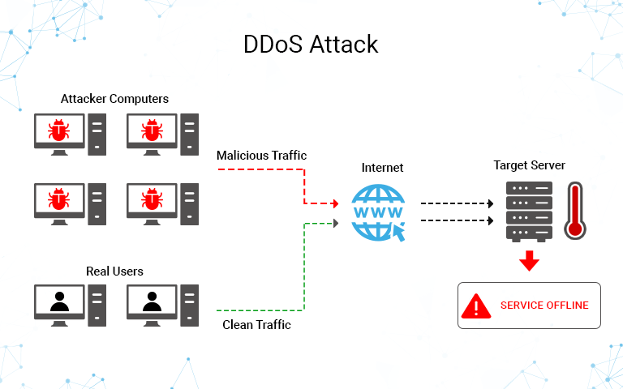
Distributed Denial-of-Service Attack: Solution: Secure the Server / Use Cloud
Notes:
The goal of a distributed denial-of-service attack (DDoS) is to overwhelm the server with requests that it cannot successfully fulfill, ultimately causing the server to be unreachable or otherwise unusable for legitimate users. The reason this works is because too much incoming data will either saturate the server’s network connection, or use up so much processing power that the server cannot keep up with actual requests. Pretty much every major networked game or online gamer service has been affected by a DDoS at one time or another.
If you are using your own hardware for game servers, it can be difficult and stressful to mitigate against DDoS attacks. It involves working closely with your ISP, as well as potentially upgrading the hardware and distributing the traffic across different servers. On the other hand, if you use a cloud hosting solution for your servers, some of the work to prevent the DDoS attacks is done by the cloud provider. The major cloud hosting platforms all have some level of DDoS prevention built in, and there also are specialized cloud-based DDoS mitigation services that can be purchased. That being said, you should never assume that the cloud hosting provider will completely prevent the potential for DDoS—it is prudent to still invest time in planning for and testing different mitigation strategies.

Slide 23
Bad Data – Solution: Fuzz Testing
a malicious user may attempt to send malformed or improper packets to the serve
In general, fuzz testing is used to discover errors in code that normal unit or quality assurance testing is not likely to discover. For a networked game, you would use fuzz testing to send large amounts of unstructured data to the server. The goal is to see whether or not sending this data to the server will crash it, and fix any bugs discovered by the process.
In order to find the most bugs, it’s recommended to use both fully randomized data as well as more structured data—such as packets that contain expected signatures even if the rest of the payload is random and unstructured. With many iterations of fuzz testing and fixing the bugs caught by fuzz testing, you can try to minimize the possibility of your game being vulnerable to bad data.

Slide 24
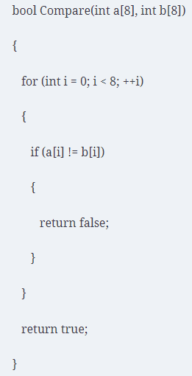
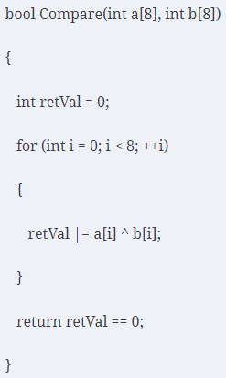
Timing Attack
Any code that compares an expected byte signature or hash versus the received signature is potentially susceptible to a timing attack. In this type of attack, information can be learned about the implementation of a particular hashing algorithm or cryptography system based on the amount of time data takes invalid data to be rejected.
Notes:
Suppose you are comparing two arrays of eight 32-bit integers to determine whether or not they are equal to each other. One array, a, represents the expected certificate. The other array, b, represents the user’s provided certificate. Your first thought might be to write a function as follows:
The return false statement seems like an innocuous performance optimization—if a particular index is a mismatch, there’s no reason to continue to compare the remainder of the arrays. However, this code is vulnerable to a timing attack because of this early return. For incorrect values of b[0], the Compare function will return faster than for correct values of b[0]. So if a user tried every possible value of b[0], they could actually determine which value is correct by testing which value causes Compare to take longer to return. This process could be repeated for every index, and eventually the user would be able to determine the entire certificate.
The solution to this is to rewrite Compare such that it always takes the exact same amount of time to execute, regardless of whether b[0] or b[7] is a mismatch. One can take advantage of the fact that a bitwise exclusive-or (XOR) yields zero if two values are equivalent. Thus, you can perform a bitwise XOR between every index of a and b, and bitwise OR those results together, as in the following rewritten Compare function:

Slide 25
Intrusions
A common route for many intrusions is to first break into a personal machine that has access to the central server, and then use this personal machine to springboard into the server system. This is referred to as a spear phishing attack.
To prevent intrusion to the server:
make sure all of the software on your servers is kept up-to-date including everything from the operating system, the databases, any software used for automation, web apps, and so on
limiting how accessible your critical server and data machines are to personal machines
may be worthwhile to enforce two-factor authentication on your servers, so that simply knowing someone’s password is not enough to gain access
Encryption for example to prevent intruders from seeing the actual password on the database server
To prevent internal intruder, it is worth to have a comprehensive logging and auditing system
make certain that any important data is backed up regularly to off-site and physical backups

Slide 26
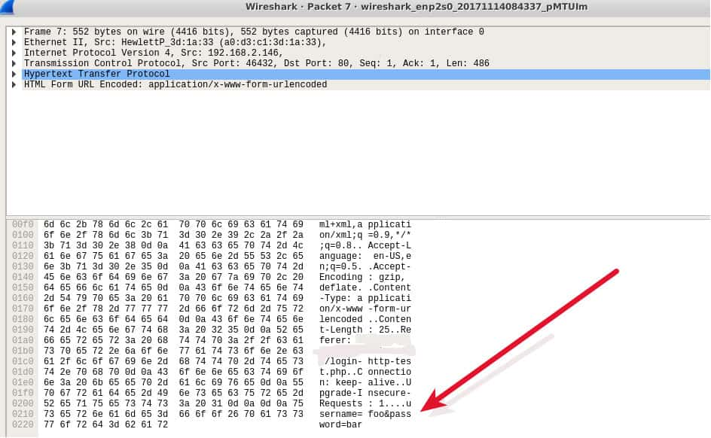
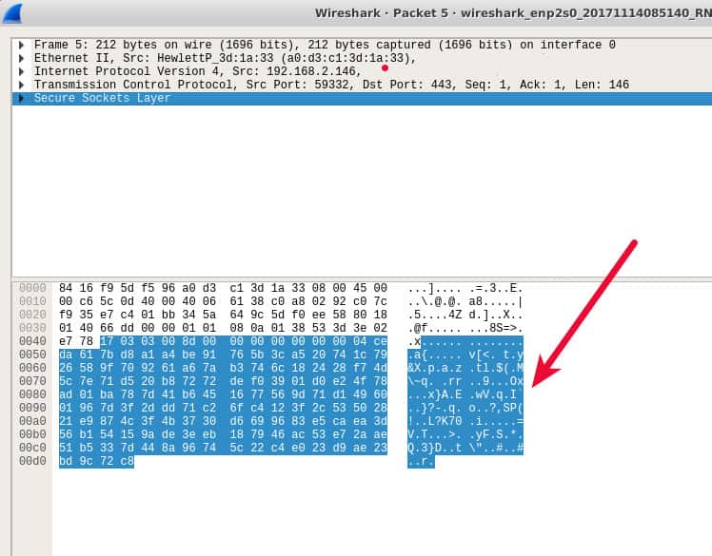
Network Security – Best Practice
It’s critical to always use HTTPS (SSL encrypted sessions) when entering and sending form data.
Notes:
https://www.comparitech.com/blog/information-security/what-is-packet-sniffing/

Slide 27
Network Security – Best Practice
Compared to other security measures, VPNs, virtual private networks, offer the most protection because they encrypt your traffic. You can also protect the metadata of your packets, such as destination addresses, by ensuring your DNS queries go through the VPN. Nevertheless, while VPNs are a security must-have, you should continue to use HTTPS even when a VPN is in place.
Restrict the physical access to the network media to ensure that a packet sniffer cannot be installed.
Use encryption to protect confidential information.
Permanently add the MAC address of the gateway to the ARP cache.
Notes:
https://docs.rackspace.com/blog/packet-sniffers-and-how-you-protect-yourself/

Slide 28
Network Security – Best Practice
Use static IP addresses and static ARP tables to prevent attackers from adding spoofed ARP entries for their machines to the network.
Turn off network identification broadcasts, and if possible, restrict the network to authorized users in order to protect the network from being discovered with sniffing tools.
Use the IPv6 instead of the IPv4 protocol.
Use encrypted sessions such as Secure Shell (ssh) instead of Telnet.
Use Secure Copy (scp) instead of a file transfer protocol (ftp).

Slide 29
References
Paper: Legal Issues Surrounding Monitoring During Network Research: http://conferences.sigcomm.org/imc/2007/papers/imc152.pdf
Unity Encryption: https://videlais.com/2021/02/28/encrypting-game-data-with-unity/

